Slide 1
SWAG
Beta Presentation
Chris Cardoz, Kevin Mccreary, Devin sun, William Gil

Slide 2
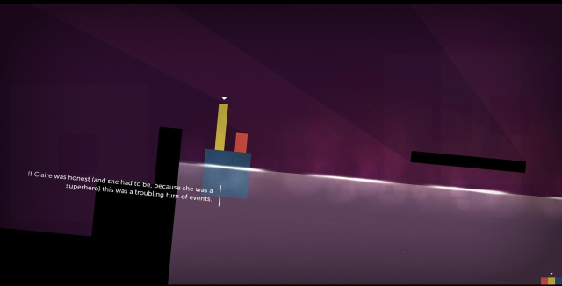
Game Idea / Inspiration
Game Idea: Platformer
Simple yet different kind of
platformer
  “Jump & Shoot”
Inspiration: Thomas was alone.
  Puzzle

Slide 3



Art – Jibby Progression

Slide 4






Art – Textures and Enemies

Slide 5
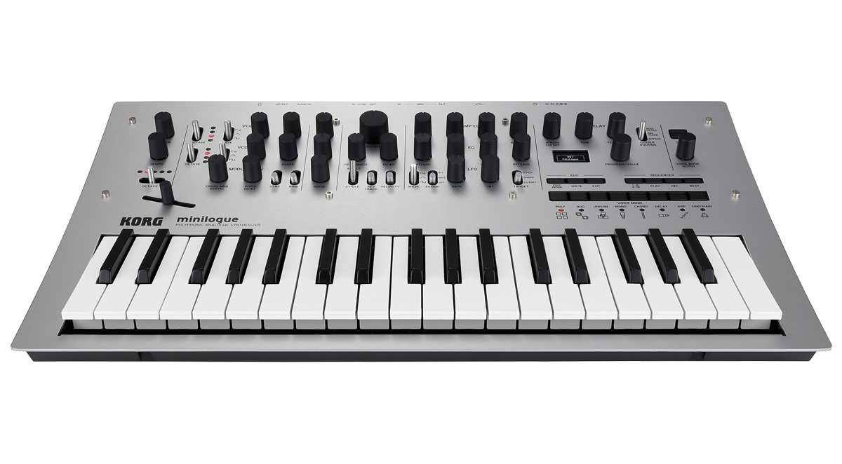
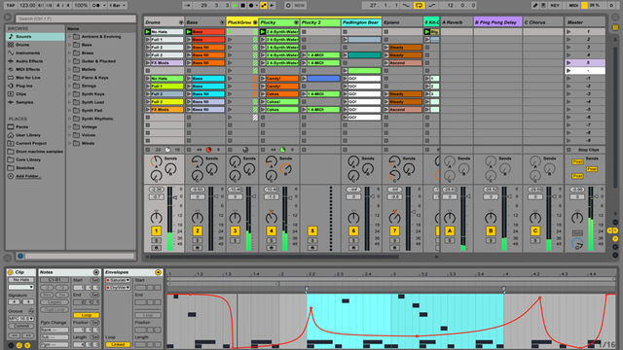
Music/Sound
Music and Sounds Produced by Chris Cardoz
Inspired by Hip-Hop Music, Sound Effects from Classic Nintendo Games
Korg Minilogue
Ableton Live 9

Slide 6
Design and Implementation
Main.cpp: Handles screen transitions, time, sends input to each active screen
LevelEditor.cpp: Reads each level from a text file named level[levelNumber].txt and sends level info to GameScreen.cpp
level[levelNumber].txt: Psuedo “Assembly” language (different Chars, ints, booleans written out in a specific order to instantiate specific objects)
GameScreen.cpp: Handles the logic for each level

Slide 7
The Other Classes
Movable.cpp: Class used for Doors, Ground, the Player
AutoMovable.cpp: Extends Movable, used for Enemies (killable or non-killable)
Camera.cpp: Extends Movable, Camera Class
Screen.cpp: Class used for each screen (GameScreen.cpp, MenuScreen.cpp, TitleScreen.cpp, HighScoreScreen.cpp)

Slide 8
Testing
Valgrind Used for Memory Leak Testing
You can press R at anytime to advance levels
Press P to pause at anytime. You can instantiate new games from the pause (menu) screen.
Press K to lose a life and invoke a screen reset at anytime.

Slide 9
Future
Mechanics
  Finish stacking
  Floating on certain pieces.
  Button/moving platform

Slide 10

Thank You!
Thank You!
Thank You!
Thank You!

